Slide 1
SOA Management
Notes:
Main Point: IBM is continuing to evolve and enhance the value that we bring to companies by building on the SOA announcements we made last fall…today we are going to talk to you about how a Business Centric Perspective to SOA is necessary to drive innovation that matters*
As you know, SOA is one of IBM’s long term strategies to enable innovation that matters. IBM will continue to deliver SOA centric offerings. But we also want you to know that IBM’s view of SOA is business centric. and we’ll talk about this important concept. Further, we’ll discuss ways to get started through existing parts of your business (people process, information). Additionally, we’ll show how reuse and connectivity is critical to support the business centric approach. We’ll then give you detail on how the specific entry points are accelerated by SOA Foundation products and the business insight these products provide.
Lastly, we’ll discuss an important part of the story called SOA Governance to ensure we’re aligning the business with IT.

Slide 2

What is governance?
Establishing chains of responsibility,
authority and communication
to empower people (decision rights)
Establishing measurement,
policy and control mechanisms
to enable people to carry out
their roles and responsibilities
The governance model defines:
What has to be done?
How is it done?
Who has the authority to do it?
How is it measured?

Slide 3

What is IT governance?
What is Governance?
It’s all part of Corporate Governance
Establishing decision making rights
associated with IT
Establishing mechanisms and policies
used to measure and control the way
IT decisions are made and carried out
What is SOA governance?
SOA Governance is a catalyst
for improving overall IT governance
Extension of IT governance focused on the lifecycle
of services to ensure the business value of SOA

Slide 4
“SOA governance may be defined as the accountability framework required to ensure the strengths of and returns from an SOA, while providing the visibility and control necessary to uphold IT governance goals, to encourage behaviors consistent with the organization's mission, strategy and values, toward achieving the enterprise’s business goals, adding value while balancing risk versus return.”

Slide 5
Need for effective SOA governance over IT governance
1. Assets, services, and business process are reused across all the company’s organizational structures.
2. Business processes and services are composed of sub processes and subservices from many areas both inside and outside of the company.
3. Data is now exposed and shared across once-isolated applications and departments in real time.
4. Applications and infrastructure are viewed as a portfolio of assets and services.
5. Connections to partners and customers can be made faster, even dynamically.
6. Different size companies with different levels of IT support are connected to the customer’s network.
7. Changing partners, suppliers, or vendors is easier and therefore can occur more often.
8. Companies can integrate on the fly for a single or multiple instances.
9. IT costs can be distributed across groups.

Slide 6
A scenario on the importance of SOA governance – step 1
Accounting department
App. 1
App. 2
Currency conversion service
1. Provide a
currency service
that fills a specific line of business (LOB)
governance core slide
Notes:
Important Points On This Slide:
Scenario shows that SOA governance is just as much if not more an organizational issue (funding model, ownership, incentives to do the right thing, etc.) than a technical one. However, technical issues like enterprise wide design, proactive monitoring to understand scaling and timing still need to be addressed.
This scenario discusses what happens when you don’t have SOA governance and describes the need for SOA governance in an SOA.
Step 1.
Say you are in the accounting department and you have two applications that require currency conversion and after just reading about web services, you feel like this would be a great candidate for a web service. So, you build your first web service – a currency conversion service.

Slide 7
A scenario on the importance of SOA governance – step 2
Sales
Accounting department
Legal
App. 1
App. 2
Order
fulfillment
Purchasing
Currency conversion service
1. Provide a
currency service
that fills a specific line of business (LOB)
2. Other
LOBs
start using
the service
governance core slide
Notes:
Step 2.
However, the good news travels fast and not only do a couple of your programs use it, but some of your coworkers in other departments hear about it and start invoking it from their programs. Before long, unbeknownst to you, programs in other departments in your company you've never even heard of are using it.

Slide 8
A scenario on the importance of SOA governance – step 3
Sales
Accounting department
Legal
App. 1
App. 2
Order
fulfillment
Purchasing
Currency conversion service
1. Provide a
currency service
that fills a specific line of business (LOB)
2. Other
LOBs
start using
the service
3. LOBs
increase use
of services /
quality suffers
governance core slide
Notes:
Step 3.
The problem is that the applications in your department and apps from other departments start to use the service more and more. Because you originally just designed this service for just the load that your two applications would produce, the currency converter service is getting run to and above capacity

Slide 9
A scenario on the importance of SOA governance – step 3
Sales
Accounting department
Legal
x
App. 1
x
x
App. 2
x
Order
fulfillment
Purchasing
x
x
Currency conversion service
1. Provide a
currency service
that fills a specific line of business (LOB)
2. Other
LOBs
start using
the service
3. LOBs
increase use
of services /
quality suffers
governance core slide
Notes:
Step 3a.
As a result of the increased load placed on the service, the response times are becoming slow and some requests are even getting dropped

Slide 10
A scenario on the importance of SOA governance – step 4
Sales
Accounting department
Legal
App. 1
App. 2
Order
fulfillment
Purchasing
Currency conversion service
1. Provide a
currency service
that fills a specific line of business (LOB)
2. Other
LOBs
start using
the service
3. LOBs
increase use
of services /
quality suffers
4. Service
is fixed at
provider’s
expense
governance core slide
Notes:
Step 4.
So you persuade your manager to buy a more powerful machine to host your service. The manager isn't happy about spending money from his budget for yet another machine that you told him is doing something simple. He is also upset that other LoB’s are “free loading” off of his budget, but he decides to put on his good corporate citizen smile and fund the upgrade for additional instances of the service.

Slide 11
A scenario on the importance of SOA governance – step 5
Sales
Accounting department
Legal
x
App. 1
x
x
App. 2
x
Order
fulfillment
Purchasing
x
x
Currency conversion service
1. Provide a
currency service
that fills a specific line of business (LOB)
2. Other
LOBs
start using
the service
3. LOBs
increase use
of services /
quality suffers
4. Service
is fixed at
provider’s
expense
5. Fix works
temporarily
but problem
reappears
governance core slide
Notes:
Step 5.
This seems to work well for awhile and all requests seem to be getting serviced in an agreeable way. However, the problem is that the number of requests start to once again grow, and the converter service starts to once again become inundated.
The requests get to a point where the service starts to once again become over flooded causing dropped requests and slow response times. One weekend, the machine crashes, and you find out about it because someone from your company that you never heard of calls you at home, asking that you come into the office to get the converter running again. Later, your manager says he's received complaints from another department about your converter not updating to the current exchange rates in a timely enough manner. He wants you to fix it, but doesn't want you to take time away from your real work or burn any more of his budget. How'd you become responsible for all this? You just wanted to build a simple service?

Slide 12
A scenario on the importance of SOA governance – step 6
Sales
Accounting department
Legal
x
x
x
x
App. 1
App. 2
Order
fulfillment
Purchasing
x
x
Currency conversion service
1. Provide a
currency service
that fills a specific line of business (LOB)
2. Other
LOBs
start using
the service
3. LOBs
increase use
of services /
quality suffers
4. Service
is fixed at
provider’s
expense
5. Fix works
temporarily
but problem
reappears
6. Maintenance
costs soar /
provider
ends service
governance core slide
Notes:
Step 6.
Because there is no way for your manager to get recovery from the other LoB’s who are using the service, and he has to fund the whole thing, he decides that it just doesn’t make economical sense and pulls the plug on the service. As a result the consumers of this service now need to scramble to replace this functionality. They are left with broken applications
How did all of this happen? Welcome to the world of SOA governance. Or in this case, the lack of any effective governance. The provider and consumer of this service became responsible for a lot more than they bargained for. How do you use services without having them spin out of control like this?
This scenario was a result of a lack of:
An ownership model that discusses who owns and is responsible for funding throughout the lifecycle of a service. Ideally the funding model will incent providers to produce high quality services and allow them to recover their costs for developing and maintaining services or even generate additional revenue for taking on these challenges.
Guarantees (could be contractual) for the consumers that a service would operate as planned with consistent quality to incent them to accept the provider as a formidable dependency. Without such guarantees, consumers are potentially put in harm’s way by depending on distributed functionality that they have no control over.
It also shows what happens when you do not take a holistic approach to designing services. You need to have an idea of the amount of load placed on a service and design to that load. Since the accounting dept in our scenario was assuming that they were the only ones to use it, there initial design was probably “good enough”. However, as soon as other consumers started to use it, this should have been a key

Slide 13
Why SOA Governance Matters
Realize business benefits
of SOA
  Business process flexibility
  Improved time to market
“ SOA governance isn’t optional—it’s imperative.
Without it, return on investment will be low and every SOA project out of pilot phase will be at risk.”
SOA Craves Governance, Gartner, Inc.,
Paolo Malinverno, January 2006
Mitigate business risk and
gain control
  Maintaining quality of service
  Ensuring consistency of service
“ SOA has turned the corner in many ways ... issues of governance have risen to the fore, and organizations are finally working through the complexities of SOA quality.”
Thinking Outside the SOA Box: ZapThink,
Jason Bloomberg, November 2006
Improved team effectiveness
  Measuring the right things
  Communicating clearly between business and IT
“ CIOs continue to struggle to align business and IT in meaningful, measurable ways. More effective IT governance processes and tools are becoming top priorities among business-savvy CIOs.”
Five Ways the Rise of IT Governance Will Change How Enterprises Buy IT, Summit Strategies, December 2005
Notes:
Important Points On This Slide:
This slide summarizes the benefits of SOA governance in three clear selling points – greater agility, risk mitigation, and communication.
Speaker Notes:
So, in the past few slides we have been trying to communicate what SOA governance is. Now we will shift gears to discuss the importance of SOA governance to the success of SOA. This slide shows three distinct selling points to the value of SOA governance:
Realize the business benefits of SOA (flexibility and improved time to market). SOA governance provides a centralized approach to delivering service oriented functionality that breeds the necessary environment of consistency facilitating interoperability between potential service consumers and providers. This approach also allows the company to realize economies of scale and as the approach matures, the resources become more efficient in delivering this functionality allowing a quicker time to market.
Mitigate business risk and regain control – if you think about what is required for an SOA to flourish – potential service consumers need to accept the functionality that service providers deliver as a dependency. If this environment is not governed, the service consumers are forced to relinquish control of their destiny into the hands of the providers, without any guarantee from the providers that the functionality will behave and perform according to expectations. Through service level agreements, governance allows us to define these expectations in a binding contract and enforce the criteria outlined within the contract.
Improved Team Effectiveness – we have already discussed the importance of communication within SOA Governance and SOA. If you recall, communication is one of the key foundational processes. Given SOA’s distributed environment, it is critical that everyone is on the same page and SOA governance provides those communication mechanisms to get everyone aligned.

Slide 14

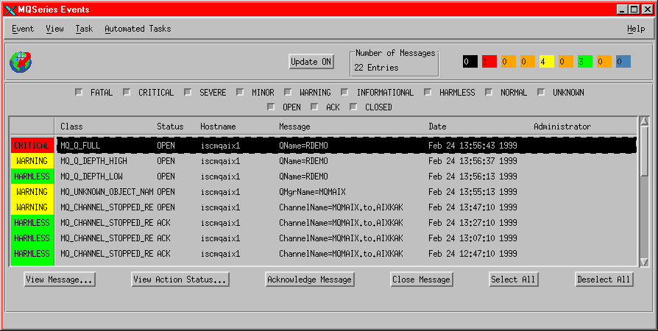

Another Example…
Application functionality is tightly bound to a static notion of a process
Little flexibility to take into account new roles or processes
Cashier
Accountant
Comptroller
Analyst
Point of Sale
Accounting
Financial Reporting
Sales Tax
Calculation
Sales Tax
Calculation
Sales Tax
Calculation
Applications
Base Functions
Management is focused on the health of the server, network and middleware
Applications are “black boxes”.
This creates redundant code and functions.
Inflexible, expensive and hard to maintain.
Notes:
This is a simple example for an existing environment – key to this picture is the operations team focus on the base functions, the systems and resources not on the applications themselves.

Slide 15
The New World: Composable Services
Cashier
Accountant
Comptroller
Analyst
Point of Sale
Accounting
Financial Reporting
X
X
X
Sales Tax
Calculation
Sales Tax
Calculation
Sales Tax
Calculation
This forces us to re-examine what we call “applications” and what we call “Base Functions”!
X
Sales Tax
Calculation
Applications
Base Functions
Services
Externalizing common functions as “services” allows for code re-use, thereby saving on development investment and maintenance expenses.
However, this creates an important dependency; if the ‘service’ is not working, the applications cannot function
✓
X
Notes:
Moving the sales tax calculation provides the added flexibility for the environment, however it changes how the operations team must manage the environment. This new shared service must be managed as part of the base function. Key message, operations has to change to understand the services.
Operations must move to understanding the new services and deal with a layer of application that before they have not.

Slide 16

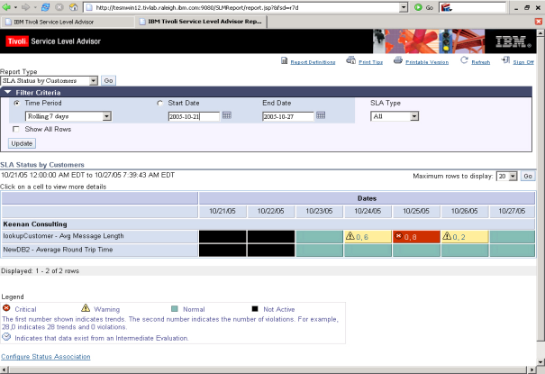
Desired End State for Managing Services
Service Provider
WSDL
XML
Service Level
Agreement
Quality of Service
Security
Performance
Service
Requestor
Service
# of requests allowed
Acceptable response time
Charge per request
Capacity
SOAP
“Contracts” are established between service requestors and providers, they include the Service Level Agreements
Management focus turns to monitoring for compliance to agreed upon service levels
“Active” management optimizes systems to avoid service violations
Notes:
Services have additional attributes defined about them including the SLA’s that must be satisfied. These SLAs must be monitored for at the service and by monitoring at the service active management can be performed to help insure meeting the SLA’s.

Slide 17
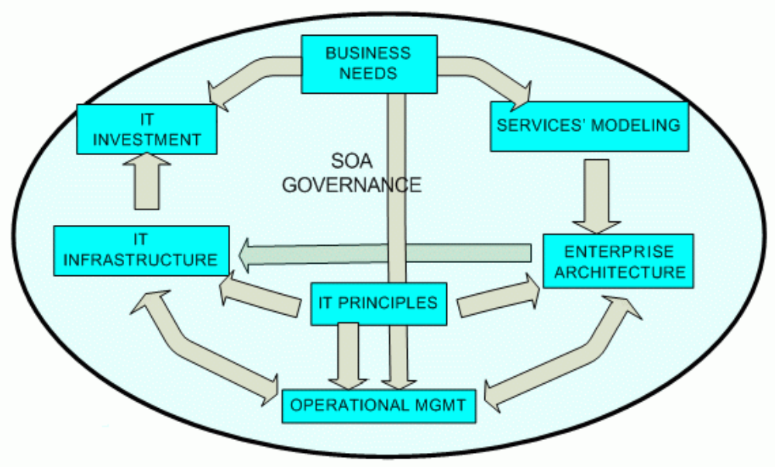
Governance framework for SOA

Slide 18



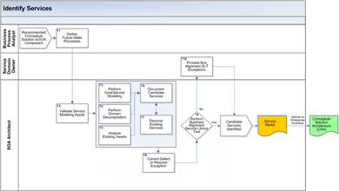
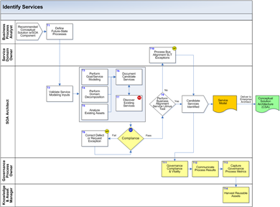
The Governance Framework
Roles
Processes
All the “elements” that we need to add to make a process well-governed
Policies
Metrics
Quality Gates
33%
10%
non-governed process
well-governed process

Slide 19
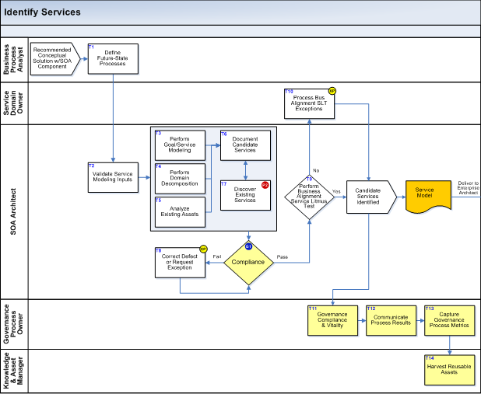
Well governed process
exception procedure
Implement Service that failed Litmus test
human decision
policy
Services should be reused instead of created whenever possible
registry lookup
quality gate
Services must be compliant with the existing reference architecture
new roles
new activities
review
Notes:
Identify Services
Governance for this process models how services are identified and ensures compliance with business needs and principles and that technical components have been specified.
Exception procedure – Process Business Alignment SLT Exceptions
There may be situations in which a service candidate which has failed the Business Alignment Service Litmus Test, but for other compelling reasons there is a desire to create an exposable service anyway. This issue should be addressed through the CIGNA exception procedure by submitting an exception request.
Policy – Discover Existing Services
In order to satisfy the policies on service reuse, a search should be made of the service repository to identify if any of the service candidates have already been exposed as services. This search should also determine if other service development projects have identified similar candidates so that the development effort can be leveraged across multiple opportunities. Policy P2 that specifies services should be re-used whenever possible drives the requirement for service discovery. If a service is discovered to exist, the candidate should be flagged in the Service Model as a duplicate.
This task updates the Service Model by identifying services that have already been placed in the Service Catalogue.
Quality Gate – Compliance
This compliance step is executed as a facilitated review using the Procedure for Work Product Inspections (which is commonly referred to as Peer Reviews).
This gate is established to review the Goal-Service Model and the Service Model, which should now be finalized up to and including the following sections: Service Portfolio, Service Hierarchy.
The Service Model is updated in the Service Specification and Service Realization processes, so as general guidance, for small or non-complex projects it is possible to consolidate the quality gates within the three processes which would be executed when the Service Model is completed at the end of Service Realization.
The procedure calls for a minimum of two inspectors, selected from the list of inspectors approved by the SOA Board. The two mandatory inspectors should be selected from those authorized as ‘Solution Architect’ and ‘Business Service Analyst’. Although the effort and time for inspections can increase dramatically if the inspection team becomes too large, it may be advisable to include additional inspectors for large or complex projects. If additional inspectors are included, the recommendation for this review would be to add a ‘Business Process Analyst’.
A checklist must be developed for ‘Service Model Verification – Identification’. This checklist should direct the inspectors thought processes, as opposed to a ‘tick off the box’ type checklist. Issues that need to be included involve the use and completeness of appropriate inputs (e.g. are all the business process models current and accurate, have all the existing assets been analyzed), as the decomposition been done to an appropriate level of granularity, have all duplicates been resolved, has the classification been performed properly, has the classification been performed consist with the standard taxonomy, etc.
Although the proviso about the size of inspection teams will apply in every instance of compliance, for the sake of brevity it will only be stated here.
Output of the compliance review is a completed Work Product Inspection Form.

Slide 20


Process, Roles, Artifacts, Requirements
Business
Architect
Business Principle
Define Business Architecture
Business Goal
trace
Service
Designer
CBM Heat Map
Policy
Design
Service
Service
Published
Policy
Deployer
Deploy
Service
Policy
Service
Deployed
Service
Consumer
Use
Service
Define the expected behavior
Service in Production
Notes:
The steps that the various roles need to follow have to be clearly documented.
Activity diagrams (process flows) can be used.

Slide 21
Process, Roles, Artifacts, Requirements
Business
Architect
Business Principle
Define Business Architecture
Business Goal
trace
Service
Designer
CBM Heat Map
Policy
Design
Service
Service
Published
Policy
Deployer
Deploy
Service
Policy
Service
Deployed
Service
Consumer
Use
Service
Define Roles and Responsibilities for each activity
Service in Production
Notes:
Note that the last role is not a “person”, but a “system”.
This is because we should also document the operational environment, where actors can be systems or applications.

Slide 22
Process, Roles, Artifacts, Requirements
Business
Architect
Business Principle
Define Business Architecture
Business Goal
trace
Service
Designer
CBM Heat Map
Policy
Design
Service
Service
Published
Policy
Deployer
Deploy
Service
Policy
Service
Deployed
Service
Consumer
Define the Artifacts that are inputs or outputs to the activities and specify how their state changes over time
Use
Service
Service in Production
Notes:
Artifacts can be documents, models, elements of the solution like services and components.
Any activity has a set of required inputs and outputs, that are ultimately the reason why that activity was performed.
We need to keep track of the state of the artifacts, as many activity affect them (see the example of a service being published after the service design activity, and the service being deployed after the Deploy activity).

Slide 23
Process, Roles, Artifacts, Requirements
Business
Architect
Business Principle
trace
Define Business Architecture
Business Goal
metric
Service
Designer
CBM Heat Map
Policy
metric
Design
Service
Service
Published
Policy
metric
Deployer
Deploy
Service
Policy
metric
Service
Deployed
Define Requirements, trace their decomposition, relate them to the business or IT elements, and define metrics to verify them
Service
Consumer
Use
Service
Service in Production
Notes:
We use the term requirement for any need, goal or request that has to be fulfilled in either the business domain or the solution domain.
See the policy slide later in the presentation.

Slide 24
ESB and SOA Management
NEW Check
Traveler
Service
Management tools naturally target ESBs as enforcement endpoints:
An ESB performs the following between requestor and service
Travel
Reservation
Process
Check Credit
Service
Book Flight
Service
ROUTING messages between services
To perform ROUTING of messages based on system capacity, Quality of Service, and SLAs
Leverage CONVERSION and TRANSFORMATION capabilities to comply with policy
Centralize HANDLING of IT events related to Services
CONVERTING transport protocols between requestor and service
Enterprise Service Bus
Management
TRANSFORMING message formats between requestor and service
Hotel
Availability
Service
Flight
Availability
Service
Book Hotel
Service
Book Car
Service
HANDLING business events from disparate sources
NEW Flight
Availability
Service
OLD Flight
Availability
Service
Notes:
Key message – IBM does not intend on building a new mediation runtime for management, but to use the existing mediation capabilities of the existing runtimes, DataPower, WESB, and MB. This is a key differentiator for the IBM management solution, from the other point vendors including Amberpoint. They require the addition of additional proxies to provide the management capabilities.

Slide 25
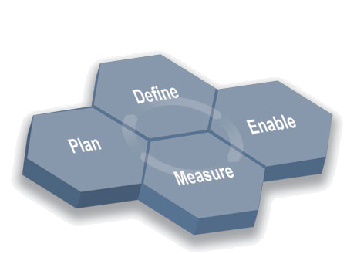
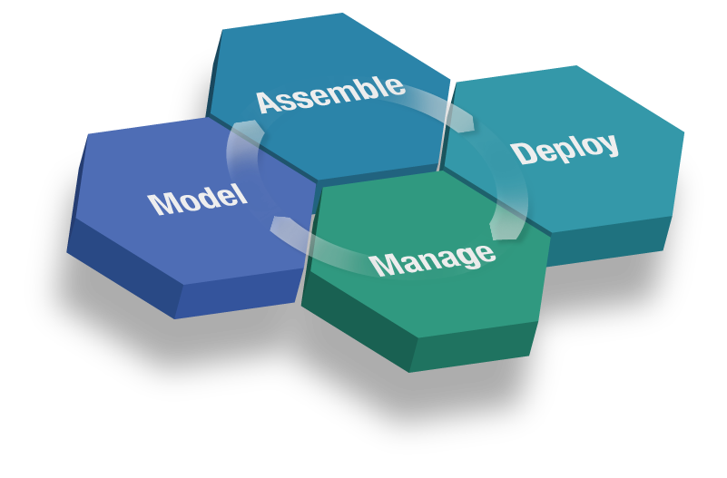
SOA Governance Definition and Enforcement
SOA Governance Lifecycle
the process in which
SOA Governance is defined
SOA Service Lifecycle
the processes being governed
the processes in which
SOA Governance is enforced
Notes:
The Governance Lifecycle (from the SGMM RMC plug-in):
The Plan Phase. Good IT and SOA governance results in better alignment of the IT organization and the needs of the business. It is in the plan phase that the needs and priorities of the business are documented along with the role of the IT organization in meeting these needs. Also, the state and maturity of the current IT organization governance is assessed, and gaps are identified. From all this analysis, the governance vision and strategy -- as well as the roadmap and plan -- are documented.
In the plan, the governance measures are put in place. These measures are used to assess how well the IT organization is aligned with the business and the business needs are met.
In the define phase, the detailed governance plan is put in place for the current cycle. In particular, the processes to be governed are specified and prioritized, and the decision rights, policies, and measures for these processes are defined.
In preparation for the next phase, detailed deployment plans are set. In some cases, these plans may include specifying or updating the structure and staffing of the SOA Governance Center of Excellence (CoE).
The enable phase is when the defined solution is rolled out to the organization. In this phase, roles are assigned, staff are trained, the decision rights many be automated in workflow tools, and the metrics collection and report mechanisms are put in place.
In the measure phase, the governance approach is executed and tuned. The governance metrics, those that that show alignment with the business, are gathered. These metrics are used in the next cycle to revise the governance approach.
The SOA Lifecycle (from the SOA Foundation Whitepaper):
The model phase includes the process of capturing your business design -- from an understanding of business requirements and objectives -- and translating that into a specification of business processes, goals, and assumptions, creating an encoded model of your business.
The assemble phase concerns assembling the information system artifacts that will implement the business design. The enterprise architect -- working with the business analyst -- can begin to convert the business design into a set of business process definitions and activities, deriving the required services from the activity definitions.
The deploy phase includes a combination of creating the hosting environment for service-based (composite) applications, and the actual deployment of those applications. This includes resolving the application's resource dependencies, operational conditions, capacity requirements, and integrity and access constraints.
The manage phase addresses the maintenance of the operational environment, and the policies realized by the deployed SOA applications. This phase includes monitoring the performance of service requests and the timeliness of service responses, maintaining problem logs to detect failures in various system components, detecting and localizing those failures, routing work around them, recovering work affected by those failures, correcting problems, and restoring the operational state of the system. The manage phase also includes managing the business model, tuning the operational environment to meet updated business design.

Slide 26
SOA Governance Lifecycle, where Governance is Defined
Assess, define, rollout, monitor and measure
the SOA Governance Solution
chains of responsibility
measurements
policies
controls mechanisms
communication
standards
processes to be governed, artifacts, tools
Process that we follow
Assessing the need for them within an organization
Defining them so they are embraced and accepted
Implementing and enabling them with the help of tools
Measuring them to metrics that reinforce initial goals
Notes:
The SOA Governance Lifecycle is the process in which we define the Governance solution.
We use the wording “Define Governance” as a shortcut, meaning “Assess, define, rollout, monitor and measure the SOA Governance Solution, following a defined method”.
The first list consist of the “elements” upon which the Governance solution is built.
The second list explains how we identify those elements and we do with them.
The process we follow for defining Governance is the IBM SOA Governance and Management Method (SGMM), the phases of which are shown in the picture.

Slide 27
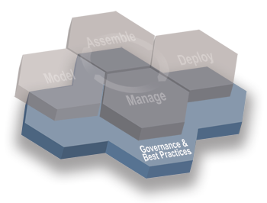
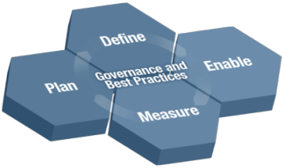
SOA Governance Lifecycle
Establish the Governance Need
  Document and validate business strategy for SOA and IT
  Assess current IT and SOA capabilities
  Define/Refine SOA vision and strategy
  Review current Governance capabilities and arrangements
  Layout governance plan
Define the Governance Approach
  Define/modify governance processes
  Design policies and enforcement mechanisms
  Identify success factors, metrics
  Identify owners and funding model
  Refine SOA Centre of Excellence
  Design governance IT infrastructure
Deploy the Governance
Model Incrementally
  Deploy governance mechanisms
  Deploy governance IT infrastructure
  Educate and deploy on expected behaviours
  and practices
  Deploy policies
Monitor and Manage
the Governance Processes
  Monitor compliance with policies
  Monitor compliance with governance arrangements
  Monitor IT effectiveness metrics

Slide 28

SOA Governance Lifecycle
Plan the Governance Need
  Document and validate business strategy
  for SOA and IT
  Assess current IT and SOA capabilities
  Define/Refine SOA vision and strategy
  Review current Governance
  capabilities and arrangements
  Layout governance plan
Define the Governance Approach
  Define/modify governance processes
  Design policies and enforcement mechanisms
  Identify success factors, metrics
  Identify owners and funding model
  Charter/refine SOA Center of Excellence
  Design governance IT infrastructure
Enable the Governance
Model Incrementally
  Deploy governance mechanisms
  Deploy governance IT infrastructure
  Educate and deploy on expected behaviors
  and practices
  Deploy policies
Monitor and Manage
the Governance Processes
  Monitor compliance with policies
  Monitor compliance with governance arrangements
  Monitor IT effectiveness metrics

Slide 29
SOA Governance Lifecycle
Define the Governance Approach
  Define/modify governance processes
  Design policies and enforcement mechanisms
  Identify success factors, metrics
  Identify owners and funding model
  Charter/refine SOA Center of Excellence
  Design governance IT infrastructure
Plan the Governance Need
  Document and validate business strategy
  for SOA and IT
  Assess current IT and SOA capabilities
  Define/Refine SOA vision and strategy
  Review current Governance
  capabilities and arrangements
  Layout governance plan
Enable the Governance
Model Incrementally
  Deploy governance mechanisms
  Deploy governance IT infrastructure
  Educate and deploy on expected behaviors
  and practices
  Deploy policies
Monitor and Manage
the Governance Processes
  Monitor compliance with policies
  Monitor compliance with governance arrangements
  Monitor IT effectiveness metrics

Slide 30
SOA Governance Lifecycle
Define the Governance Approach
  Define/modify governance processes
  Design policies and enforcement mechanisms
  Identify success factors, metrics
  Identify owners and funding model
  Charter/refine SOA Center of Excellence
  Design governance IT infrastructure
Plan the Governance Need
  Document and validate business strategy
  for SOA and IT
  Assess current IT and SOA capabilities
  Define/Refine SOA vision and strategy
  Review current Governance
  capabilities and arrangements
  Layout governance plan
Enable the Governance
Model Incrementally
  Deploy governance mechanisms
  Deploy governance IT infrastructure
  Educate and deploy on expected behaviors and practices
  Deploy policies
Monitor and Manage
the Governance Processes
  Monitor compliance with policies
  Monitor compliance with governance arrangements
  Monitor IT effectiveness metrics

Slide 31
SOA Governance Lifecycle
Define the Governance Approach
  Define/modify governance processes
  Design policies and enforcement mechanisms
  Identify success factors, metrics
  Identify owners and funding model
  Charter/refine SOA Center of Excellence
  Design governance IT infrastructure
Plan the Governance Need
  Document and validate business strategy
  for SOA and IT
  Assess current IT and SOA capabilities
  Define/Refine SOA vision and strategy
  Review current Governance
  capabilities and arrangements
  Layout governance plan
Enable the Governance
Model Incrementally
  Deploy governance mechanisms
  Deploy governance IT infrastructure
  Educate and deploy on expected behaviors
  and practices
  Deploy policies
Monitor and Manage
the Governance Processes
  Monitor compliance with policies
  Monitor compliance with governance arrangements
  Monitor IT effectiveness metrics

Slide 32
SOA Service Lifecycle, where Governance is Enforced
Identify, design, implement, test, deploy and manage
the SOA Solution
Business Processes
Services
Components
Information
Interaction and Collaboration
Architecture
Well-governed processes that we follow
Define Service Focus, Owners and Funding
Identify, Specify and Realize Services
Design, Assemble, Test and Deploy Services
Manage Quality, Levels, Change and Security of Services
Notes:
The SOA Lifecycle is the set of processes in which we enforce the Governance solution.
We use the wording “Enforce Governance” as a shortcut, meaning “Identify, design, implement, test, deploy and manage a SOA Solution following a set of well-governed processes”.
The first list consist of the “elements” upon which the SOA solution is built.
The second list gives an example of some of the processes that we could decide to govern. Their number and type depends on the scope of the governance solution.

Slide 33
The Processes to be Governed
Service
Planning
Service
Modeling
Service Implementation
Service Management
Define
Service Focus Process
Identify Services Process
Design Services Process
Manage
Quality of Service Process
Identify
Service Owners Process
Specify Services Process
Assemble Services Process
Manage
Service Levels Process
Define
Service Funding Process
Realize Services Process
Test Services Process
Manage
Service Change Process
Deploy Services Process
Manage
Service Security Process
Notes:
The Diagram below presents the 14 SOA Processes “to be governed”. These processes have been identified as those processes that are most significantly impacted/altered by the adoption of an SOA.
Each of the 14 SOA Affected Processes are associated with 4 distinct categories
Service Planning – more business and strategy aligned.
Service Modeling – these represent the SOMA related processes associated with “Macro Design”
Service Implementation – these processes model the Micro Design, Coding, Testing and Deployment aspects of a service.
Service Management – these processes model the run time and monitoring aspects of the Services environment.
These processes are based on the ITIL (IT Infrastructure Library) framework
http://www.itil.co.uk/
A brief description of each process follows:
Define Service Focus
This process models the desired degree of service orientation and compliance to it.
Identify Service Owners
This process identifies service domains and service owners and establishes governance for ownership.
Define Service Funding
This process establishes the rules for service funding for new and enhanced services and how this is governed.
Identify Services
Governance for this process models how services are identified and ensures compliance with business needs and principles and that technical components have been specified.
Specify Services
Governance of service specification ensures that services adhere to architectural principles, non functional requirements, standards and service deployment requirements.
Make Service Realization Decisions
Governance deals with ensuring that services have been assigned to appropriate component containers for realization of functionality and that required prototypes have been completed.
Design Services
Governance of service design addresses the design time considerations that are bounded by the stated SOA principles and guidelines. Compliance processes must be implemented to monitor the creation, maintenance and adherence to the modeled SOA design process
Assemble Services
Service assembly allows developers to create new services that follow predefined rules and processes to ensure that the services being assembled will be in compliance with stated SOA standards.
Test Services
Services must be tested at multiple levels to ensure they meet the stated functional and non functional objectives and comply with the service contract criteria.
Deploy Services
Governance of the service deployment process includes the registration of the service and ongoing measurement; to include the physical location of the service, information about the service’s provider, its owner, usage terms and conditions, technical constraints, security requirements, service levels, and versioning.
Manage Quality of Service
This process is used to govern the delivered quality of service on an ongoing basis.
Manage Services Levels
This process manages the day to day service operations and the ability to meet IT and business needs.
Manage Services Change
This process monitors the adherence to polices and standards associated with the implementation of new or modified services.
Manage Service Security
This process covers the lifecycle of security concerns, including planning, operational measures, evaluation and audit.

Slide 34
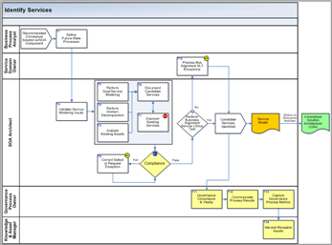
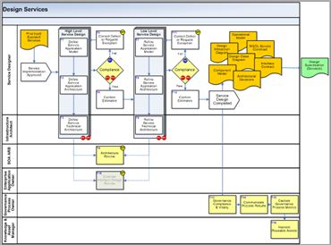
Examples of Governed Processes
Well-governed process: a process with policies and controls in place
Service
Planning
Service
Modeling
Service Implementation
Service Management
Define
Service Focus Process
Identify Services Process
Design Services Process
Manage
Quality of Service Process
Identify
Service Owners Process
Specify Services Process
Assemble Services Process
Manage
Service Levels Process
Define
Service Funding Process
Realize Services Process
Test Services Process
Manage
Service Change Process
Deploy Services Process
Manage
Service Security Process
Notes:
The Identify Services Process and Metrics:
One of the key elements of service oriented architecture is the layer of services. Services may be offered and exposed to the outside world of partners and customers, and/or internally to other lines of business or projects within an organization. The Service Identification process uses three complementary approaches to identify services.
Many organizations attempt to identify services through an analysis of existing applications. This bottom-up approach will clearly help to ensure that the existing functionality of applications is not lost in the creation of services. However, by itself it cannot properly identify all of the services that are required and may derive service candidates that are not at the right level of granularity.
A top-down approach based on process decomposition may provide more insights and generally provides better indications of the granularity required. However, by itself it cannot ensure all existing functionality is retained in the new services. Nor, does it ensure that all of the services necessary to meet the goals and KPIs (Key Process Indicators) of the target system are included.
Goal-Service Modeling establishes alignment between services and business goals.
The most complete method to identify service candidates is to combine top-down (process decomposition) with bottom-up (current asset analysis) and cross-sectional (candidates based on alignment to goals and KPIs). IBM’s Service Oriented Modeling and Architecture (SOMA) employs this multi-faceted approach.
The Design Services Process and Metrics:
During Service Realization, decisions were made upon which patterns and templates would be used to develop each service. These decisions are documented in the service model. The design process is used to take the services that are listed in the service catalogue and elaborate the information in the service model so that the services can be implemented and deployed. Effectively, the Application Model, the Application Architecture and the Technical Architecture are defined and elaborated. Realization decisions are made to complete the patterns and templates and progressively more depth and detail to the design specifications so that the developers can begin to build the services.

Slide 35
Enforcement at Development Time
exception procedure
Implement Service that failed Litmus test
human decision
policy
Services should be reused instead of created whenever possible
registry lookup
quality gate
Services must be compliant with the existing reference architecture
new roles
new activities
review
Notes:
Identify Services
Governance for this process models how services are identified and ensures compliance with business needs and principles and that technical components have been specified.
Exception procedure – Process Business Alignment SLT Exceptions
There may be situations in which a service candidate which has failed the Business Alignment Service Litmus Test, but for other compelling reasons there is a desire to create an exposable service anyway. This issue should be addressed through the CIGNA exception procedure by submitting an exception request.
Policy – Discover Existing Services
In order to satisfy the policies on service reuse, a search should be made of the service repository to identify if any of the service candidates have already been exposed as services. This search should also determine if other service development projects have identified similar candidates so that the development effort can be leveraged across multiple opportunities. Policy P2 that specifies services should be re-used whenever possible drives the requirement for service discovery. If a service is discovered to exist, the candidate should be flagged in the Service Model as a duplicate.
This task updates the Service Model by identifying services that have already been placed in the Service Catalogue.
Quality Gate – Compliance
This compliance step is executed as a facilitated review using the Procedure for Work Product Inspections (which is commonly referred to as Peer Reviews).
This gate is established to review the Goal-Service Model and the Service Model, which should now be finalized up to and including the following sections: Service Portfolio, Service Hierarchy.
The Service Model is updated in the Service Specification and Service Realization processes, so as general guidance, for small or non-complex projects it is possible to consolidate the quality gates within the three processes which would be executed when the Service Model is completed at the end of Service Realization.
The procedure calls for a minimum of two inspectors, selected from the list of inspectors approved by the SOA Board. The two mandatory inspectors should be selected from those authorized as ‘Solution Architect’ and ‘Business Service Analyst’. Although the effort and time for inspections can increase dramatically if the inspection team becomes too large, it may be advisable to include additional inspectors for large or complex projects. If additional inspectors are included, the recommendation for this review would be to add a ‘Business Process Analyst’.
A checklist must be developed for ‘Service Model Verification – Identification’. This checklist should direct the inspectors thought processes, as opposed to a ‘tick off the box’ type checklist. Issues that need to be included involve the use and completeness of appropriate inputs (e.g. are all the business process models current and accurate, have all the existing assets been analyzed), as the decomposition been done to an appropriate level of granularity, have all duplicates been resolved, has the classification been performed properly, has the classification been performed consist with the standard taxonomy, etc.
Although the proviso about the size of inspection teams will apply in every instance of compliance, for the sake of brevity it will only be stated here.
Output of the compliance review is a completed Work Product Inspection Form.

Slide 36





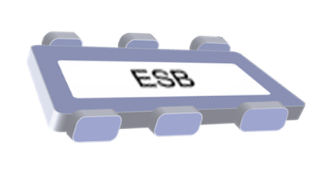
Enforcement at Runtime
Dynamic Endpoint Selection of a Policy using WSRR and WESB
WebSphere Service Registry and Repository
Publish
Find
Enrich
Manage
Govern
Retrieve Policy information
3
Message
Message
ESB
Mediation
Message
1
2
4
Message is transformed and routed to the selected endpoint
A message is received
Invokes a selection mediation
Executes matching algorithm to identify the provider service for requestor service
5
Notes:
This slide shows a scenario that demonstrates the use of runtime mediations to dynamically access service metadata in the WSRR.
The scenario shows the retrieval of candidate service descriptions and the dynamic selection and late binding to a service.
The provider service is selected dynamically based on message content.
The requester service description is obtained from the Service Registry, including its terms and relationships. The relationships to qualified service providers are wired in the Service Registry. These relationships are used to obtain service descriptions and terms about the wired candidate services. Business rules are used to select the service to invoke form the candidates (business rules are not assumed to be services advertised in the Service Registry).
Discovery – stereotypical ‘find’ either during development (locate services to target consumer request) or runtime (locating services to target consumer request to OR locate hosted service to route inbound message to, for purposes of concealing the actual endpoint, transforming and routing to a newer version, routing based on content (currency, time zone, requester classification). Note that operational efficiency use case deals with using information collected through monitoring to route for reasons of failover, load balancing, operational QoS). Note that at development time discovery is often performed for the purposes of reuse. Asset management processes may govern visibility and reuse of a service.
Selection – involves a human or a selector mediation component or a matchmaking engine to choose the service instance to invoke.
Binding and invocation – executing invocation terms such as logging, auditing, billing and those related to ‘provisioning’ the message (adding things like WS-Security and WS-RM headers to a SOAP message) – applying security policy and reliable messaging policy

Slide 37
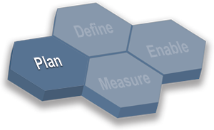
Establishing decision rights: Scenario
Scenario:
SOA initiative already underway
Services shared across lines of business
Challenges:
No clear decision maker or owner
Confusion about funding of shared services
Standards for services QoS ill defined

Slide 38

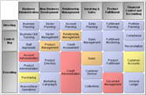
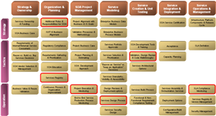
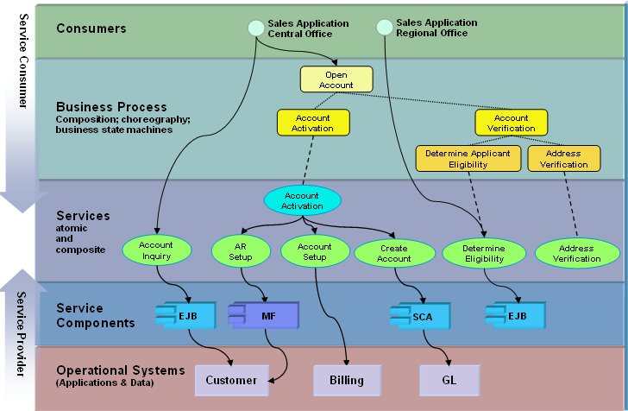

Artifacts in the SOA Governance Solution
Business Goals
SOA Governance Top Map
CBM
Integration (Enterprise Service Bus)
Objectives
Quality of Service
Strategy
Policies
SOA Solution Stack
Data Architecture
Strategy
Tactic
Tactic
Tactic
SOA Governance Framework
Notes:
We start from the business goals, from which we derive business and IT principles (Not shown in the diagram).
In the “solution” part (on the left) we show the Account Administration business component that is decomposed (using SOMA, not shown in the diagram) until the “Determine Applicant Eligibility” service is identified and created.
In the “governance” part (on the right) we show how we identify one governance aspect (a component of the top map) based on the business and IT principles and how some policies are identified that will enforce that specific governance aspect.
The Policies are just a graphical representation of any structured approach to define everything that is needed to enforce a specific aspect of governance from the top map, which is SGMM is summarized with the “Governance Framework”.
Methods and processes are not depicted in this slide for clarity.
In the right side (governance definition) we are following the SGMM method.
The SOA Governance framework is then enforced on several methods and processes that are used inside our architectural framework, affecting the business architecture, the data architecture, the integration layer, etc.

Slide 39
Outcome in the absence of SOA governance
Company invests in creation and infrastructure for providing services that do not give a return on investment.
Despite high IT spending, company does not achieve its strategic objectives.
Ad hoc IT project design, implementation, and project management practices, defeating benefits of SOA
Poor performance, slow response times.
System outages, inadequate data for troubleshooting.
Enterprise data is dispersed, duplicated, or managed by multiple ad hoc systems.
Services are created at a fine-grained level requiring complex and expensive collaboration for simple business processes.
Business performance measurements are not in place; losses incurred in IT investment go unnoticed.

Slide 40
SOA Security Encompass all Aspects of Security
5
5
5
5
Service Consumer
consumers
SCA
Portlet
WSRP
B2B
Other
SOA Security
Identity
Authentication
Authorization
Confidentiality, Integrity
Availability
Auditing & Compliance
Administration and Policy Management
Service Consumer
4
4
4
4
business processes
business processes
process choreography
process choreography
3
3
3
3
Services (Definitions)
services
atomic and composite
atomic and composite
2
2
2
2
Service Provider
Service
components
Service Provider
1
1
1
SAP
Custom
1
Custom
OO
ISV
Packaged
OO
Application
Application
Application
Packaged
Custom
Application
Application
Custom
Outlook
Application
Application
Operational
systems
Application
Custom Apps
Platform
Supporting Middleware
Unix
OS/390
MQ
DB2
Notes:
Managing the SOA Security includes:
Identity Services
Authentication Services
Consistent authorization across the infrastructure components (policy managed based on a single decision point implementing authorization across layers)
Auditing & Compliance to security policy
Trust/Map identities between various security sub-systems
Confidentiality, Integrity and Availability
Administration and Policy Management

Slide 41
Web Services and SOA Security
Business Process Execution Language
Business
Processes
WS-Coordination
WS-Security
WS-Reliable
Messaging
Quality
of Service
WS-Transactions
WSDL
WS-Policy
UDDI
Description
and Discovery
SOAP, SOAP Attachments
Other protocols
Other services
Messaging
and Encoding
XML, XML Infoset
WS-Secure
Conversation
WS-Federation
WS-Authorization
Transports
Transport
WS-Security
Policy
WS-Trust
WS-Privacy
OASIS 1.0 WS-Security (framework)
SAML
Kerberos
profile
X.509
profile
REL
profile
Liberty
Mobile
profile
Username
profile
SAML
profile

Slide 42
Web Services Security Specifications*
WS-
SecureConversation
WS-
Federation
WS-
Authorization
WS-Policy
WS-Trust
WS-Privacy
WS-Security
SOAP Foundation
how to manage and broker trust relationships in a heterogeneous federated environment (federated identities)
supports SSO (on/off), pseudonyms, attribute svc (query for more info)
capabilities and constraints of the security policies on intermediaries and endpoints (e.g. req’d security tokens, encryption algorithms, privacy rules)
a framework for trust models that enables Web services to securely interoperate (Security Token Service)
a model for how Web services and requesters state subject privacy preferences and organizational privacy practice statements
how to manage authorization data and authorization policies
how to attach sig and encryption headers to SOAP messages
how to attach security tokens (X.509 certs, Kerberos tickets, SAML) to msgs
how to manage and authenticate msg exchanges between parties (e.g. security context exchange & session key establishment/derivation)
supports secure, long-running sessions (detects replay attacks)
* www.ibm.com/developerworks/library/ws-secmap/

Slide 43
SGMM
SOA Governance and Management Method
Plan
Define
Enable
Measure
Project
Start Up
Refine SOA Principles and Standards
Create SOA Governance Framework
Execute
Enablement
Execute Measurement
SOA Business Discovery
SOA Center of Excellence
Define Development and Operational Aspects
Determine IT Environment Readiness
Governance Tools and Infrastructure
Create SOA Governance Plans
Exit Review
The SOA governance and management method is an end-to-end approach to designing, implementing, and improving governance of an SOA
see Appendix F

Slide 44



Plan Phase Activities
Define
Enable
Plan
Measure
High-Level Tasks
Project Start Up
Typical Work Products
Current IT Assessment
Current Organizational Assessment
Principles Policies and Guidelines
Standards
Operational Model
Current IT Environment
Capability Interview Findings
Change Readiness Interview Findings
Change Readiness Assessment
Situational Analysis And Impact Report
Gather Current State Documentation
Conduct Method Tailoring Workshop
Conduct Kickoff Meeting
SOA Business Discovery
Determine Existing Governance Structure
Identify SOA Business and IT Principles
Create the IT Governance Baseline
Determine IT Environment Readiness
Understand Current IT Environment
Measure Governance Capabilities
Define and conduct change readiness survey
Notes:
Here we show the three activities in the Plan phase. In each activity, we listed the tasks.
The tasks shown in blue (in this and in the next slide) are tasks that are covered in detail in the Governance Definition Lab (G2300).
In the Determine Existing Governance Structure we request that the client complete an IT governance self assessment using the Cobit Questionnaire. The questionnaire would be parsed into relevant sections based upon the existing IT organizational structure. Note that some portions of the questionnaire may be out of scope for the engagement, e.g. security, however the answers to the questionnaire provide a customers view of the state of their IT governance.
In the Identify SOA Business and IT Principles task we look to ensure alignment of business and IT by reviewing existing documented business principles (if any) and determine if there are additional principles needed to properly implement a Service Oriented Architecture. Business principles are the underlying construct that ensures IT aligns with business. It is essential for the success of a SOA initiative that the alignment of business and IT exists. This task looks at existing documented business principles and determines if there are additional business principles that need to be formulated to properly implement a Service Oriented Architecture.
In most cases customers will not have business principles well documented if they exist at all.

Slide 45
Define Phase Activities
Define
Enable
Refine SOA Principles and Standards
Plan
Measure
Update SOA Business Principles
Update SOA IT Principles & Standards
Principles, Policies, Guidelines, and Standards
Service Ownership Model
Process Definitions
Governance Organization
Job Roles – Responsibilities and Competencies
RACI Matrices
Measurements Program
Transition Plan
Change Readiness Assessment
Situational Analysis And Impact Report
Create SOA Governance Framework
Define Service Ownership Model
Establish SOA Governance Mechanisms
Update Governed Processes
Define Metrics
Document SOA Governance Mechanisms
Define Roles & Responsibilities
SOA Center of Excellence
Create the CoE Structure
Elaborate the CoE Structure
Define Development & Operational Aspects
Governance Tools and Infrastructure
Policies for Reuse security & compliance
Quality gates for development processes
Quality gates for operational processes
Tools and infrastructure building blocks
Create SOA Governance Plans
Exit Review
Build SOA governance plans
Define the SOA transition plan
Operational change readiness assessment

Slide 46
Enable Phase Activities
Define
Enable
Plan
Measure
Execute Enablement
Execute the Transition Plan
Initiate SOA Governance Organization Changes
Initiate the SOA Center of Excellence
Initiate the SOA Governance Communication Plan
Initiate the SOA Governance Mentoring Plan
Initiate the SOA Governance Education Plan
Update the Transition Plan
Implement Tools and Infrastructure for SOA Governance
Implemented governance framework
Implemented CoE

Slide 47
Measure Phase Activities
Define
Enable
Plan
Measure
Execute measurement
Measure Effectiveness of SOA Governance Processes
Measure the Effectiveness of Organizational Change
Review and Refine Operational Environment
Revised governance framework
  Measurement Reports
  Updated Procedures Documentation
  Updated Key Decision Record

Slide 48
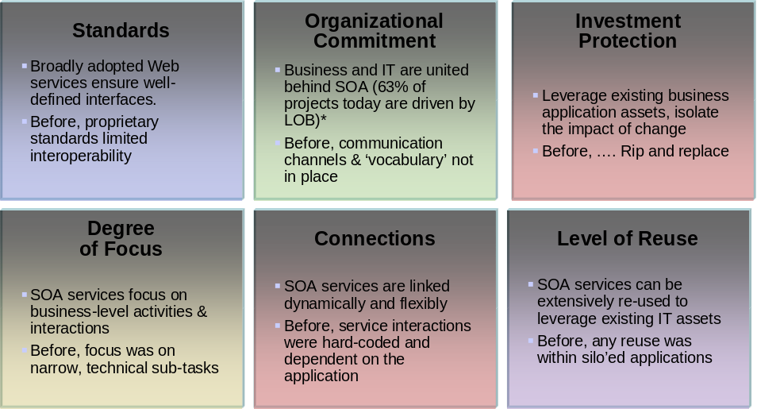
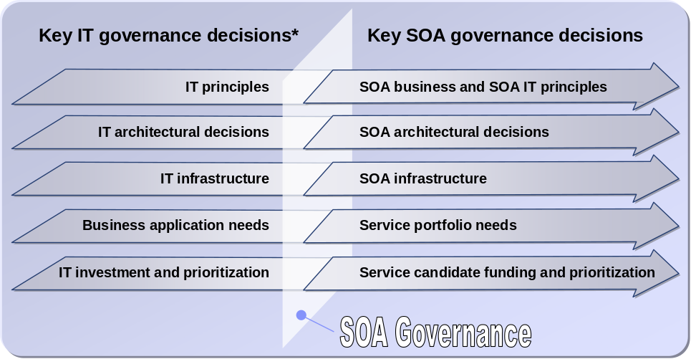
Governance issues are highlighted by the adoption of SOA
… the risk is to end up with all the drawbacks of application silos compounded by the costs of loose coupling without any of the benefits of cost reduction and time to value associated with service reuse.
… governance of SOA therefore needs to change or at least shift emphasis from traditional IT governance.
Because SOA emphasizes notions of reuse, loose coupling and cross-organizational, cross-line of business sourcing of components (services), the means by which the various IT processes need to be governed are changed….
Notes:
SOA is a new approach to thinking about building IT systems in a way that is more agile and has better affinity to the needs of the business. Because SOA emphasizes notions of reuse, loose coupling and cross-organizational, cross-line of business sourcing of components (services), the means by which the various IT processes need to be governed are changed.
The following figure outlines some of the areas where SOA changes the classical approach to building IT systems, and therefore suggests the areas in which the Governance of SOA needs to change or at least shift emphasis from traditional IT governance.
The shift outlined on the first row suggests SOA has a strong implication on the management and governance of change within an IT organization. Historically systems were built to minimize change, to be rock solid and immutable for reasons of reliability, availability, security, performance etc. Where as the demands for reliability etc. have not gone away, they have been balanced with a need to build systems that are sufficiently agile (e.g. they can change in a controlled fashion) to support the needs of the business as the business environment changes. Hence the Governance aspects related change management and versioning of services is critical to SOA success.
The notion of incremental development cycles associated with SOA also imply an emphasis on the governance of service change and versioning, similar to what was discussed previously. However, rapid iterative development also has implications on the governance of funding and requirements gathering, more decision points for requirements; design approvals etc. are encountered with rapid iterative development than with traditional waterfall methods.
The shift away from application silos towards the discipline of building services and composite applications that might be sourced from various service providers from lots of different organizations, suggests changes to the way the SOA portfolio is governed and managed. And of course, building applications as silos suggested a much easier task of doing impact analysis, change control etc. When the IT portfolio has many services and composite applications, the impact analysis, scope of ownership and control are much more complicated. Of course, the task of informing impacted parties of upcoming changes, agreeing and approving those changes and funding and provisioning multiple versions of a service are all more tricky when applications are no longer monoliths.
The shift to more loosely coupled systems also has implications similar to the move away from monolithic application silos. This move however also adds the notion of the possibility of dynamic provisioning of service fulfillment at runtime, making notions of Service Level Agreement and governance of service change much more important to the SOA world than it was for traditional application development.
Because SOA emphasizes the notion of reuse by emphasizing the construction of composite application by orchestrating services sourced from many different service owners, the governance aspects related to reuse, change control and new service creation are emphasized. If it is not easy and reliable to assemble an application from reusable services, it is more likely that developers will build everything from scratch, control everything and end up with all the drawbacks of application silos compounded by the costs of loose coupling without any of the benefits of cost reduction and time to value associated with service reuse.
Finally, the focus on service interface design within SOA means a stronger emphasis on the governance of new service creation, and in particular the discipline of establishing and adhering to design standards to make interoperability easier and therefore reuse more likely.

Slide 49
Common organizational SOA Governance Roles
Business Sponsorship
  The Executive Sponsor
  Business process Owners
  Service Domains Owners
Coordination
  The Executive Steering Committee
  The Architecture Review Board
  Business Unit Committees
Advice and Compliance
  SOA Operations Board
  SOA Center of Excellence

Slide 50


Establishing SOA Center of Excellence
Accelerate mobilization of SOA
SOA CoE
What is our Future State?
People
Develop SOA Vision, Goals
Where are we?
Technology
Organization, Technology &
Asset Assessment
Mobilize
the
SOA CoE
Where are we going?
Processes
Develop Organization &
Governance for SOA CoE
How do we get there?
Services
Create SOA Artifacts
and Best Practices

Slide 51
Enterprise Architecture and SOA Governance
Strategy
Business
Business
Information
Technology
Opportunity
Strategy
Technology
Availability
Strategy
Enterprise wide focus
Enterprise Architecture
Ensures Alignment
Business
IT
Architecture
Architecture
Planning
Processes
Applications
Ensures Vitality
Information
Data
People
Technology
Locations
Transition Plan
Ensures Compliance
Project focus
Business Operating Environment
Design and
and IT Infrastructure
Delivery
IT Solutions
Notes:
Slide Objective:
This slide shows the relationship between governance and EA The key points to be made:
although SOA projects are EA in nature, SOA does not equal EA
EA is broader and SOA is a subset; in fact EA should encompass SOA but there will be projects undertaken where only a subset of SOA principles may apply (e.g., batch uploads, or CRM packaged implementation, or authorization switch, etc)
EA is a mechanism used by organizations to lower costs, improve alignment with business and IT, to optimize resources, improve productivity, etc.
EA when effective drives best practices and standards into projects both development and infrastructure
Successful EA requires alignment with the business and IT goals which is reflects in this diagram through the business and IT strategy
IBM’s CBM technique is a unique approach for addressing both business and IT strategies
To reiterate, Enterprise Architecture (SOA) provides the basis for aligning IT with business needs through appropriate business and IT architectures, principles, and practices. Note that IT itself is a horizontal resource that is needed and used across all LOBs within an Enterprise.
The key premise of SOA is to make IT resources more flexible and better able to meet an increasingly broad range of business needs – this makes IT intertwined in the daily operations of the business. In such a situation, enterprise architecture becomes a critical link between corporate and IT governance, and as companies adopt SOA as enterprise architecture, SOA governance becomes the primary way that companies can establish principles for the control of their organizations.
Effective SOA Governance defines the processes, practices and organizations (aligned with the strategic directions of the enterprise an in the context of established principles) to ensure this IT alignment with the business needs by ensuring compliance of projects to the defined SOA, and ensuring that the SOA itself is kept vital to meet the ever changing business needs.
This slide shows the relationship between governance and EA (SOA.) The key points to be made:
To reiterate, Enterprise Architecture (SOA) provides the basis for aligning IT with business needs through appropriate business and IT architectures, principles, and practices. Note that IT itself is a horizontal resource that is needed and used across all LOBs within an Enterprise.
The key premise of SOA is to make IT resources more flexible and better able to meet an increasingly broad range of business needs – this makes IT intertwined in the daily operations of the business. In such a situation, enterprise architecture becomes a critical link between corporate and IT governance, and as companies adopt SOA as enterprise architecture, SOA governance becomes the primary way that companies can establish principles for the control of their organizations.
Effective SOA Governance defines the processes, practices and organizations (aligned with the strategic directions of the enterprise an in the context of established principles) to ensure this IT alignment with the business needs by ensuring compliance of projects to the defined SOA, and ensuring that the SOA itself is kept vital to meet the ever changing business needs.
Slide Details:
Governance is Key to Bind IT to Business:
An EA must be flexible and evolve constantly if it is to support the business changes needed by an organization. Governance focuses on:
Governance of Projects & Programs
”Are we doing these projects the way we said we wanted them done?”
An EA must provide an organization and associated architecture governance processes designed to ensure its specifications are either adhered to or – when appropriate – waived and exceptions allowed. “Compliance Process”
Governance of the Architecture itself
”Are our target architectures still right?”
”Are we still moving in the right direction?”
An EA’s architecture cannot be defined at a single moment in time - there needs to be a vision on how its constituent parts will evolve over the short and long term and how it, as a whole, will change to meet the changing demands of the business – i.e. how it is kept vital and appropriate for the enterprise? “Vitality Process”
Enabled by Governance Framework.

Slide 52
SOA Governance: A four-tiered model
Scaled as suitable to current and future corporate infrastructure and vision
Business Governance
Steering Committee
Sponsorship
Leadership
Opportunity
Management
Project
Management
Business Unit
Executives
CIO
CFO
Leader
COE
Domain 1
Domain 2
Domain 3
Domain n
Governance
Leadership
and Core Team
Bus
Exec
IT
Exec
Bus
Exec
IT
Exec
Bus
Exec
IT
Exec
Bus
Exec
IT
Exec
Initiative Team
Initiative Team
Initiative Team
Initiative Team
Initiative Team
Business Team
Lead
IT Team
Lead
Business Team
Lead
IT Team
Lead
Business Team
Lead
IT Team
Lead
Business Team
Lead
IT Team
Lead
Business Team
Lead
IT Team
Lead
Project Team
Project Team
Project Team
Project Team

Slide 53
The Business Governance Steering Committee
Sponsorship
Business Governance
Steering Committee
Business Unit
Executives
CIO
CFO
Mission
Set the strategic direction of enterprise Business Governance. Identify business needs, opportunities and broader strategic relationships to insure the collective efforts of the businesses result in a benefit to the enterprise. Management buy-in is mandatory at the top and from the onset, across all businesses
Responsibilities
Defining strategic direction
Prioritizing opportunities and initiatives based on strategic objectives
Obtaining budget and finalizing portfolio of initiatives based on actual budget
Composition
A senior business executive from each line of business (individuals who have the money and influence to make things happen)
CIO
CFO
BU Presidents, VPs
Creating strategic importance and Insuring benefits across the enterprise

Slide 54
The Governance Leadership Team
Leader
COE
Domain 1
Domain 2
Domain 3
Domain n
Leadership
Governance
Leadership
and Core Team
Bus
Exec
IT
Exec
Bus
Exec
IT
Exec
Bus
Exec
IT
Exec
Bus
Exec
IT
Exec
Mission
Work collaboratively to synchronize initiatives / investments across lines of business with the strategic goals outlined by the Steering Committee to insure the collective efforts of the businesses result in a benefit to the enterprise
Responsibilities
Initial prioritization of opportunities and initiatives based on strategic objectives
Representing BU business and IT goals, plans, and activities
Assigning resources to Initiative and Project Teams and providing strategic context to their assignees
Composition
Leader COE
Key business executives from each line of business (domain)
IT executives that are responsible for supporting each of the lines of business
Synchronizing enterprise strategy and tactical investments

Slide 55
The Initiative Teams
Initiative Team
Initiative Team
Initiative Team
Initiative Team
Initiative Team
Opportunity Management
Business Team
Lead
IT Team
Lead
Business Team
Lead
IT Team
Lead
Business Team
Lead
IT Team
Lead
Business Team
Lead
IT Team
Lead
Business Team
Lead
IT Team
Lead
Mission
Creates and prioritizes initiatives and develops business cases required to enable the Governance Leadership Team to make decisions that insure the collective efforts of the businesses result in a benefit to the enterprise. Initiatives should be sized for decision making, linked to business objectives and a business case, measurable, and have accountability.
Responsibilities
Participate in the process to:
  Document current state and already underway or planned initiatives
  Define future-state requirements
  Define initiatives required to move from current to future state
  Conduct cost/benefit analysis and develop business case
On an ongoing basis, track results against ROI/business case
Initiative Team Leads responsible for communicating with Corporate IT and reporting back to the Governance Leadership Team
Composition
Business and IT managers from each line of business involved in, or effected by, the initiative
One IT representative and one business representative will be Initiative Team Leads—and eventually be responsible for moving the initiative forward
Facilitating prioritizations and tactical decisions

Slide 56
The Project Teams
Initiative Team
Business Team
Lead
IT Team
Lead
Project Team
Project Team
Mission
Implement initiatives efficiently and effectively to maximize the benefit to the enterprise
Responsibilities
Define a detailed project plan and resource requirements
Timely and complete delivery of projects, within budget
Clear communication around status, requirements and risks
Gathering data/actuals and tracking milestones against ROI estimates
Project Teams
Composition
Business and IT resources required to implement (may include BU-specific or enterprise resources)
Defining and implementing project objectives and plans

Slide 57
SOA
Governance
Lifecycle
BUSINESS DOMAIN
Business Governance Steering Committee
CxOs, Executives, LOB managers
SOA Governance
Policy, Measurement and Control Process
PLAN (Establish Governance Need)
Identify Operational Need
Identify Goals & Metrics
Define SOA Governance Plan
DEFINE (Define Governance Model)
Document Standards & Policies
SOA Governance Leadership Team
Business / IT Leaders
Document Compliance Criteria
Define Development Process
Model Performance Indicators
Capture Assets & Publish
ENABLE (Enact Governance Model)
Establish Change Management
IT DOMAIN
Discover / Provision Services
IT Project Team
Project Managers and Practitioners
Ensure Audit Trail & Signoff
Record Service Configuration
Validate & Authenticate Users
MEASURE (Monitor and Manage)
Measure Business Performance
IT Operations
Operations Managers and Staff
Monitor Key Indicators
Monitor & Measure Operations

